Slide 1
Linux System Monitoring
Thomas Czyzyk

Slide 2
What is System Monitoring and why do it?
-Observe processes on the computer in real time
-Check for stability and stop system failure
-Helps pinpoint the problems

Slide 3
How its implemented in Linux
-top/uptime commands
-free command
-df command
-awk/sed commands
-Using these to create a script

Slide 4
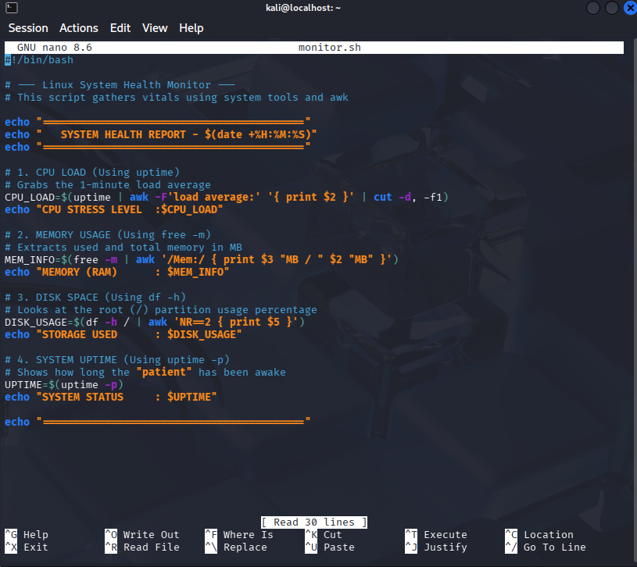
The Script

Slide 5
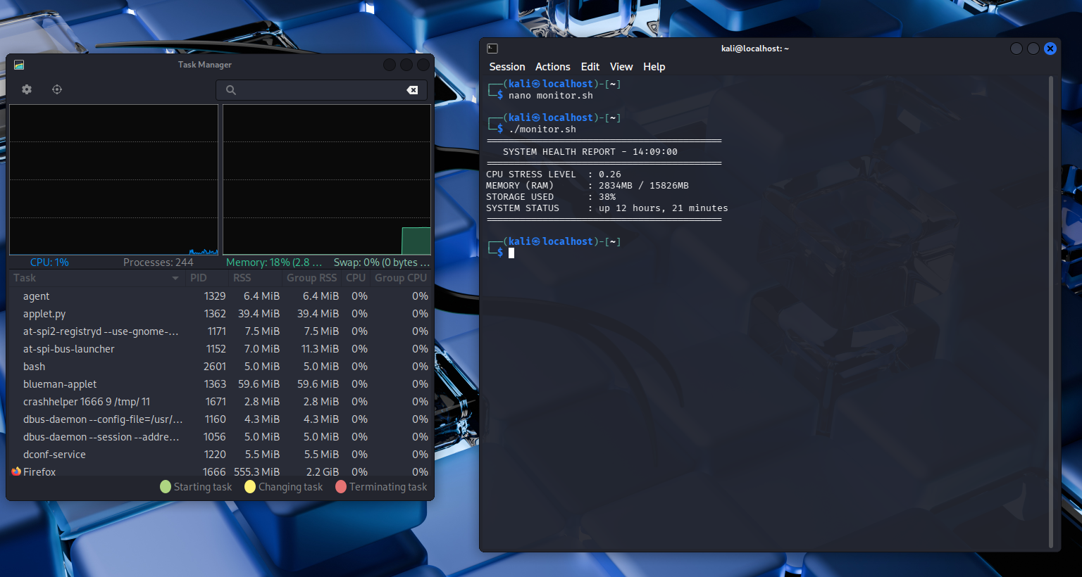
Output (idle)

Slide 6
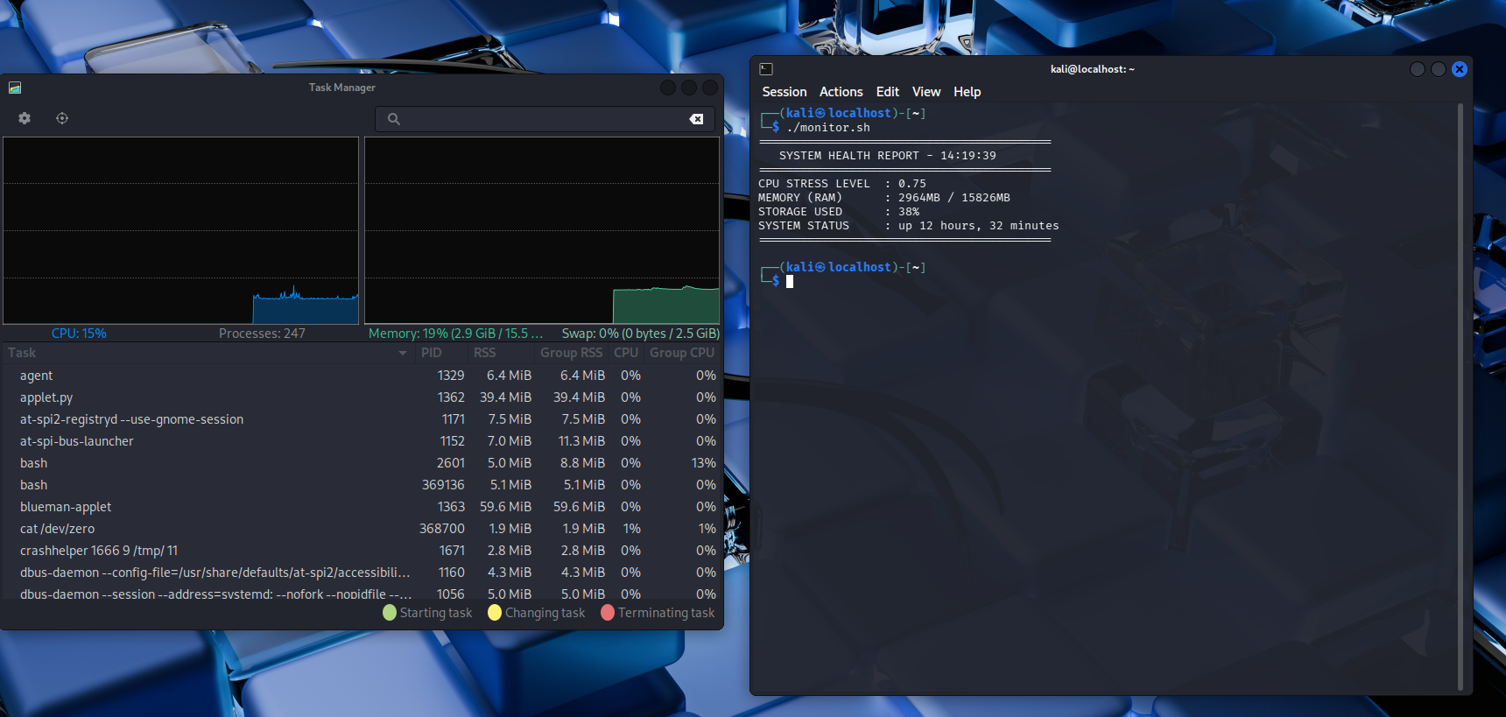
Output (active CPU)

Slide 7
Thank you

